Slide 1

MSE 311: Thermodynamics of Materials
Lecture 16: Phase diagram-II
Weishu Liu
Department of Materials Science and Engineering
Southern University of Science and Technology (SUSTech)
Email: liuws@sustech.edu.cn
Office: North Tower, Rm310

Slide 2
Phase diagram of binary system
Complete liquid and solid solutions (idea solution)
Partial solid solution
Complete liquid miscibility and solid immiscibility
42. Phase diagram – Partial solid solution
Chapter 10
Gibbs Free energy Composition and Phase diagrams of Binary System
Ref. Introduction to the thermodynamics of Materials, 6th edition, D. R. Gaskell, and D. E. Laughlin

Slide 3
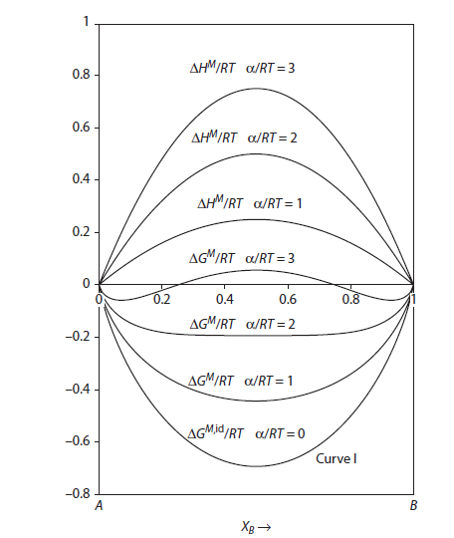
Effect of interaction parameter: Ω
Regular solution
Curve I: ideal solution

Slide 4
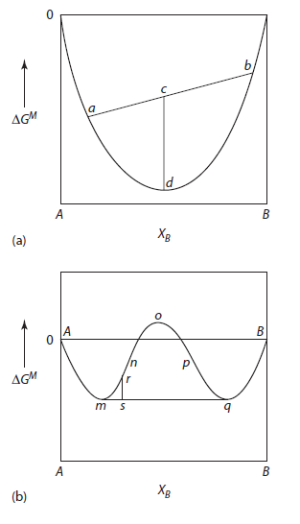
Miscibility gap
Complete solution
Curve (mnopq):
The Gibbs energy to form a single solution
Line (mq):
The Gibbs energy to form a mixing of m and q
miscibility gap
if the homogeneous solution of composition r separates into the two coexisting solutions m and q , the Gibbs free energy of mixing of the system is decreased from r to s .

Slide 5



Criteria for the coexisted two phase
The equilibrium coexistence of two separate solutions at the temperature T and pressure P requires that
Ref
Criteria for the coexisted two phase
Equivalent Criteria for the coexisted two phase
a_{A}(in solution m)=a_{A}(in solution q)
a_{B}(in solution m)=a_{B}(in solution q)

Slide 6
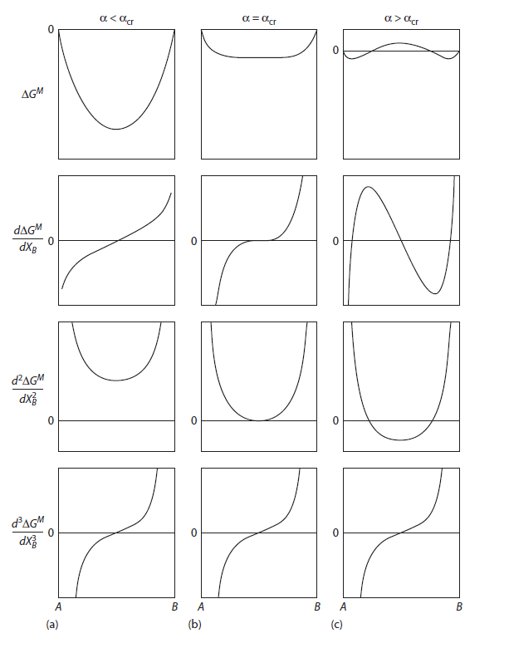
Criteria for phase stability

Slide 7
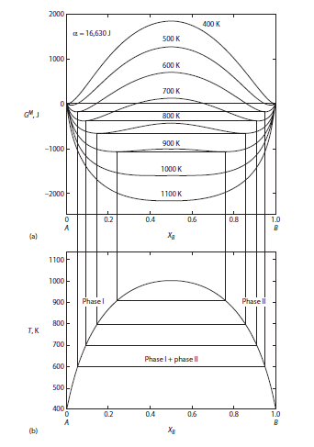
Criteria for phase stability
X_{A}= X_{B}=0.5
α=2
α=2 is the critical value
α>2 phase separation
α<2 single phase
α=2
T_{cr} is the critical temperature
T>T_{cr} single phase
T<T_{cr} phase separation

Slide 8
Criteria for phase stability in regular solutions
Equation of binodal curve
Equation of spinodal curve
Miscibility gap
T>T_{cr} single phase
T<T_{cr} phase separation
The loci of the double tangent point

Slide 9
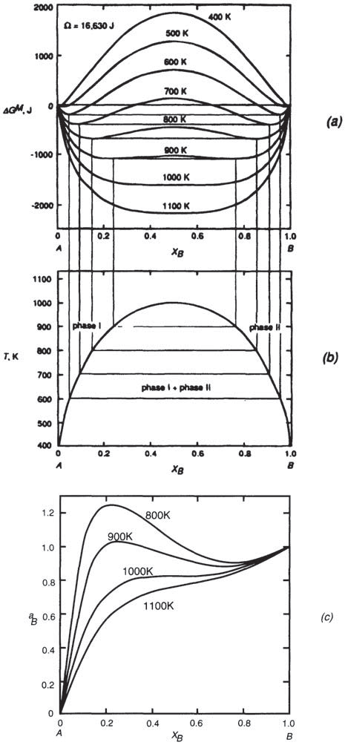
Criteria for phase stability in regular solutions
Activities obtained from the intercepts, with the X_{B} = 1 axis, of tangent drawn to the free energy curves as:
At T = T_{cr} and X_{B} = 0.5,
the activity exhibits a horizontal inflexion
The effect of temperature on the activities of component α_{B} derived from the ΔG^{M}
α_{B}=X_{B}

Slide 10
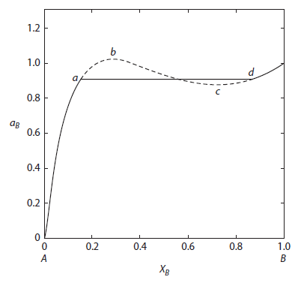
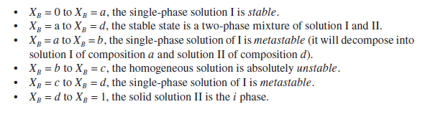
Criteria for phase stability in regular solutions
absolute
unstable
Since at T_{cr} and X_{B} = 0.5, both second and third derivatives of ∆G^{M} with respect to X_{B} are zero
Dash line bc: ∂a_{B}/ ∂X_{B} is negative
This is violates an intrinsic criterion for stability ∂a_{i}/ ∂X_{i} >0

Slide 11

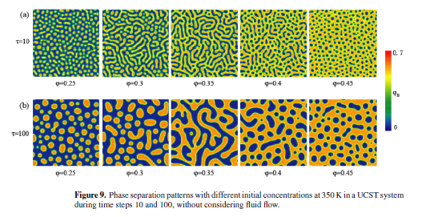
Spinodal decomposition

Slide 12
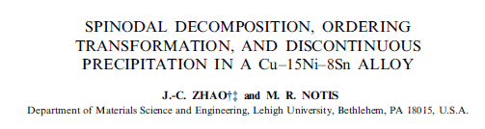
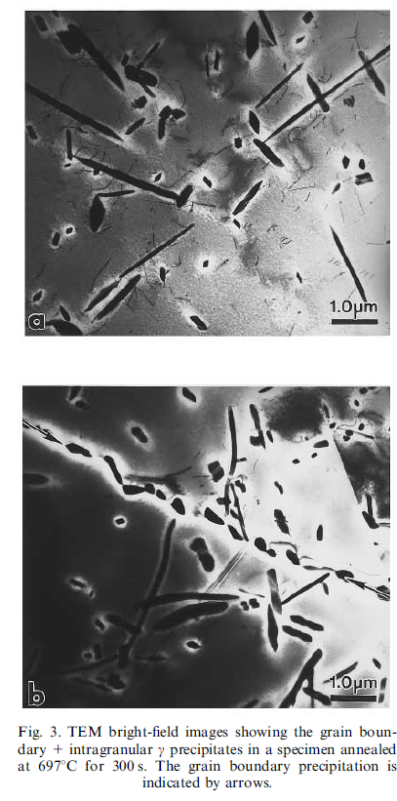
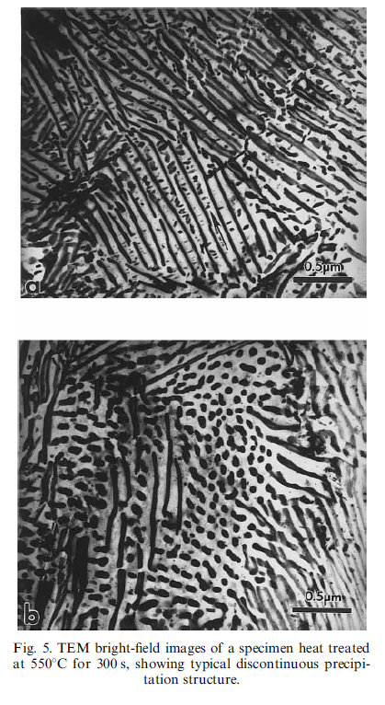
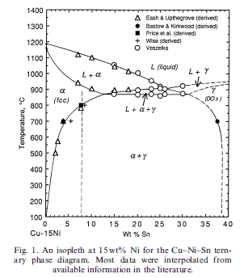
Spinodal decomposition
697
550

Slide 13
Phase diagram of binary system
Complete liquid and solid solutions (idea soludtion)
Partial solid solution
Complete liquid miscibility and solid immiscibility
43. Eutectic Phase diagram
Chapter 10
Gibbs Free energy Composition and Phase diagrams of Binary System
Ref. Introduction to the thermodynamics of Materials, 6th edition, D. R. Gaskell, and D. E. Laughlin

Slide 14
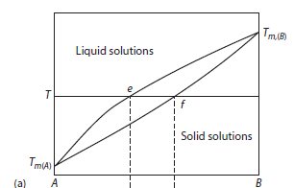
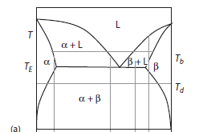
Phase diagrams
Complete mutual solid solubility
of A and B requires A and B
The same crystal structures
Comparable atomic size
Similar electronegativities and valences
Partial solid solution
If any one of these conditions
is not met, then one or more two-phase regions will occur in the solid state

Slide 15
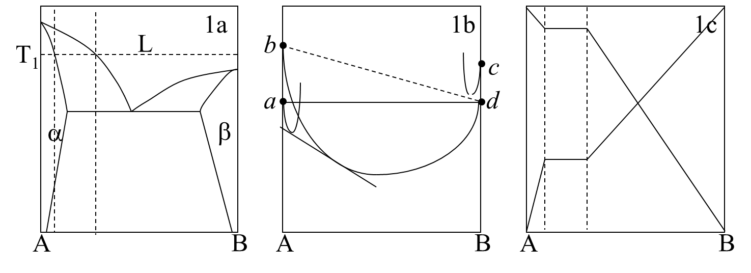
Phase diagrams, ΔG and a: T₁
In Fig. 1b, a and d are for solid A and liquid B, which are standard states (ΔG =0). b and c are for liquid A and solid B.
Fig. 1c is activity-composition relationships by using solid for A and liquid for B as standard states. Assuming the liquid solution follows Raoult’s law and the solid solution follows positive deviation from Raoult’s law.

Slide 16
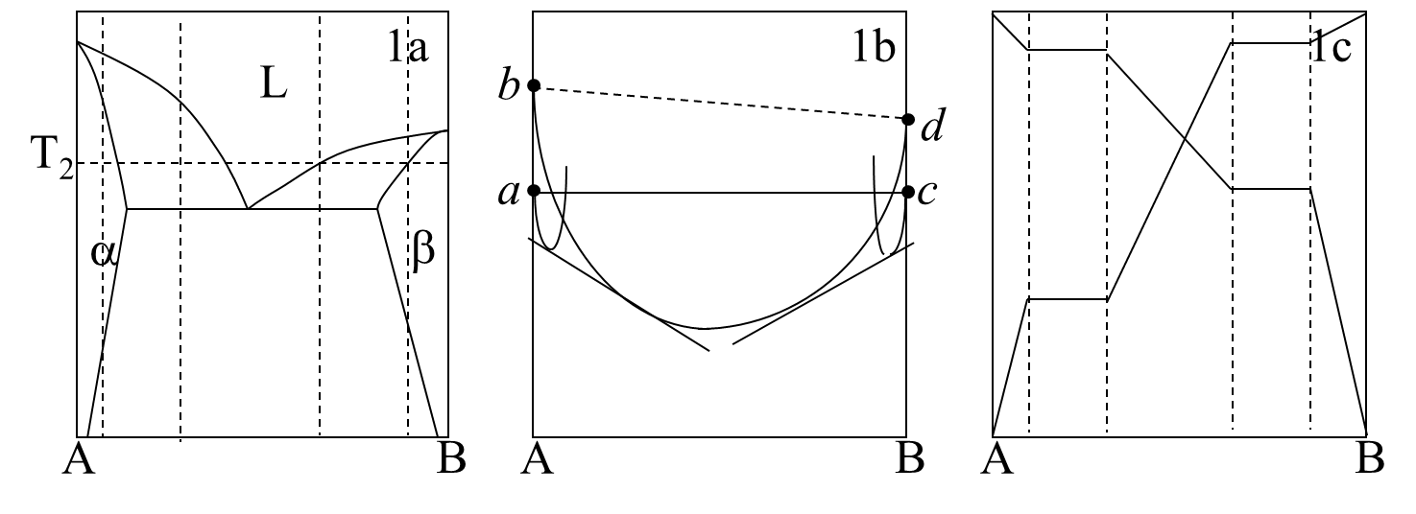
Phase diagrams, ΔG and a: T₂
In Fig. 1b, a and c are for solid A and solid B, which are standard states (ΔG =0). b and d are for liquid A and liquid B.
Fig. 1c is activity-composition relationships by using both solid A and B as standard states.

Slide 17
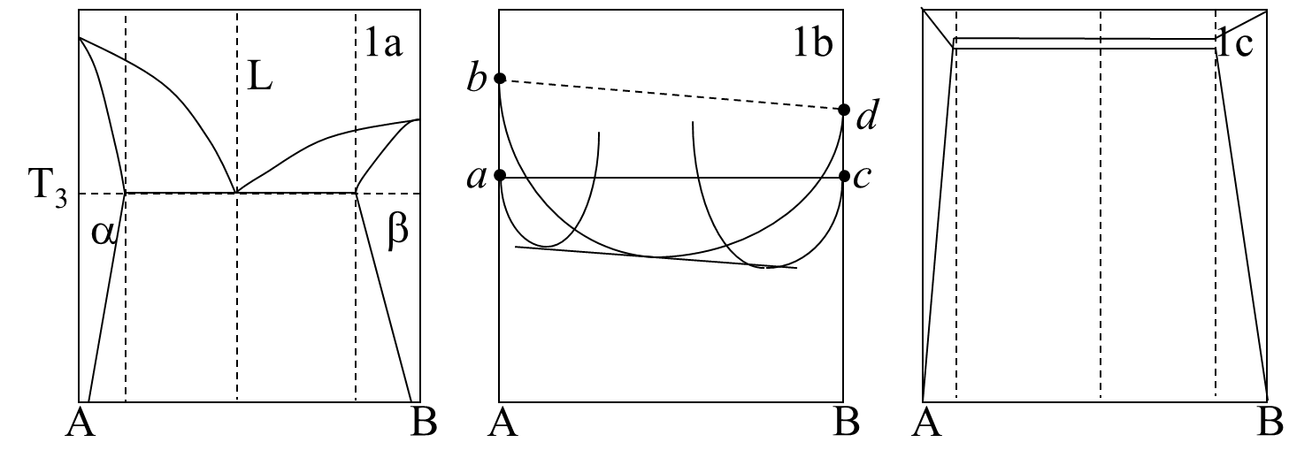
Phase diagrams, ΔG and a: T₃
In Fig. 1b, a and c are for solid A and solid B, which are standard states (ΔG =0). b and d are for liquid A and liquid B.
Fig. 1c is activity-composition relationships by using both solid A and B as standard states.

Slide 18
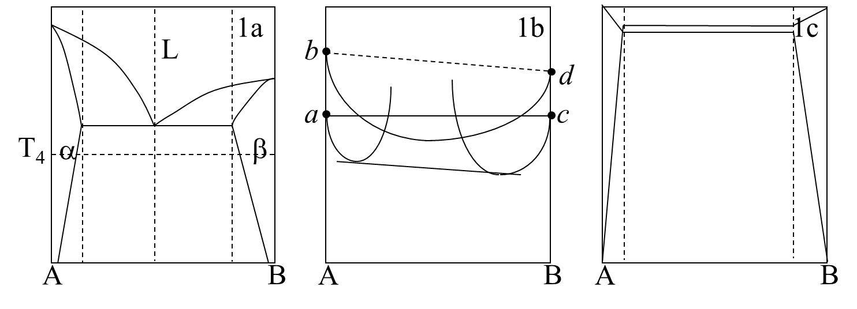
Phase diagrams, ΔG and a: T₄
In Fig. 1b, a and c are for solid A and solid B, which are standard states (ΔG =0). b and d are for liquid A and liquid B.
Fig. 1c is activity-composition relationships by using both solid A and B as standard states.

Slide 19
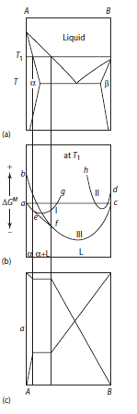
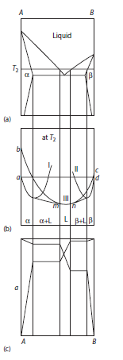
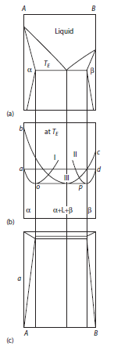
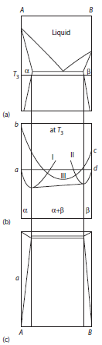
Eutectic phase diagram

Slide 20
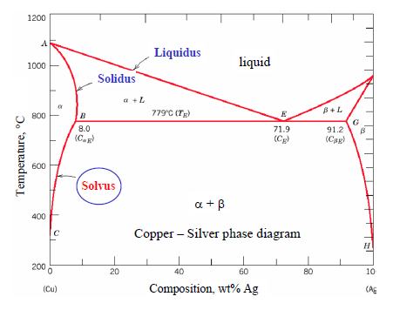
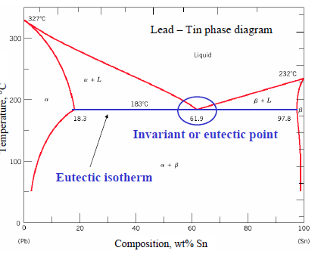
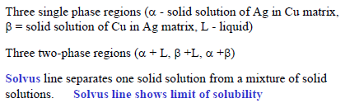
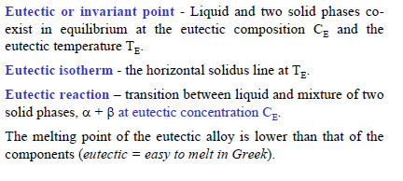
Application

Slide 21
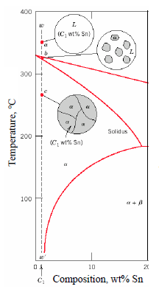
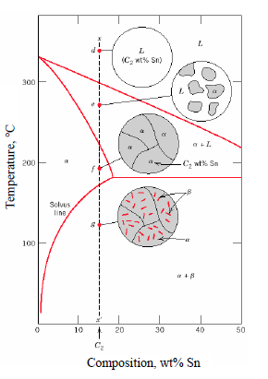
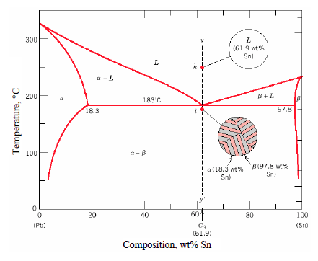
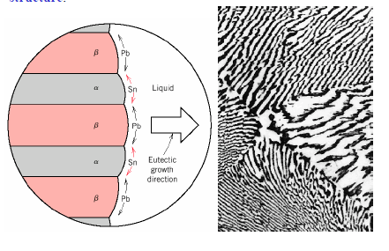
Application
L→α+β
Eutectic structure
L→L+ α → α
L→L+ α → α→ α+β

Slide 22
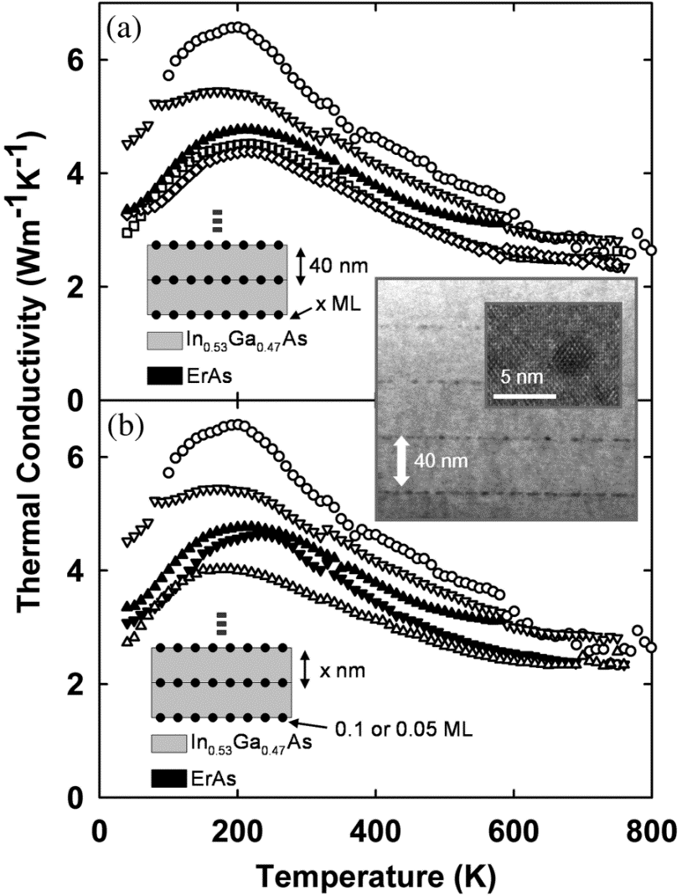
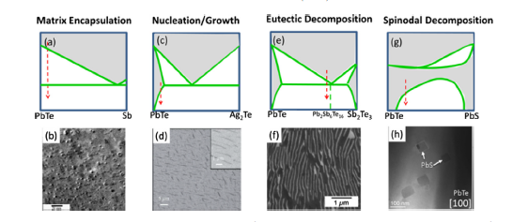

Nano precipitation for small thermal conductivity
Thermoelectric figure of merit
S: Seebeck coefficient
σ: electrical conductivity
κ: thermal conductivity

Slide 23
Phase diagram of binary system
Complete liquid and solid solutions (idea soludtion)
Partial solid solution
Complete liquid miscibility and solid immiscibility
44. Phase diagram-Complete liquid miscibility and solid immiscibility
Chapter 10
Gibbs Free energy Composition and Phase diagrams of Binary System
Ref. Introduction to the thermodynamics of Materials, 6th edition, D. R. Gaskell, and D. E. Laughlin

Slide 24
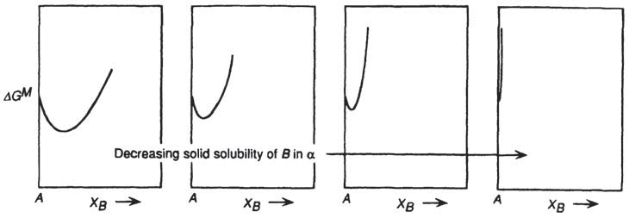
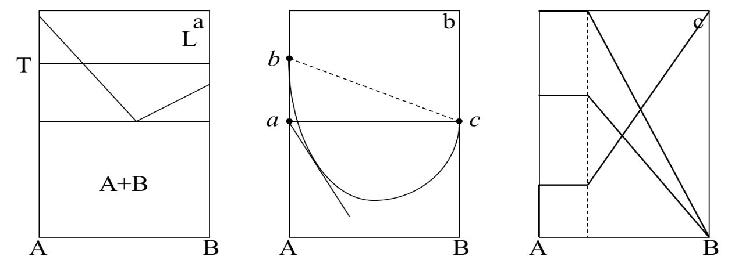
Phase diagrams, ΔG and a
If the solubility is immeasurable small, A and B are insoluble.
In Fig. 1b, a and c are for solid A and liquid B, which are standard states (ΔG =0). b and d are for liquid A and solid B.
Fig. 1c is activity-composition relationships by using solid A and B as standard states.
any pure substance presents an infinite chemical sink to any other substance, or conversely, it is impossible to obtain an absolutely pure substance

Slide 25
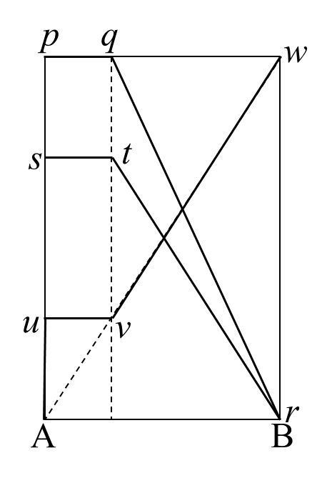
Phase diagrams, ΔG and a
Activity-composition relationships by assuming the liquid solution follows Raoult’s law.
pqr is the activity of A with respect to pure solid A
s is the activity of pure solid A with respect to liquid A
str is the activity of A with respect to liquid A as the standard state
- Auvw is the activity of B with respect to liquid B as the standard state.

Slide 26
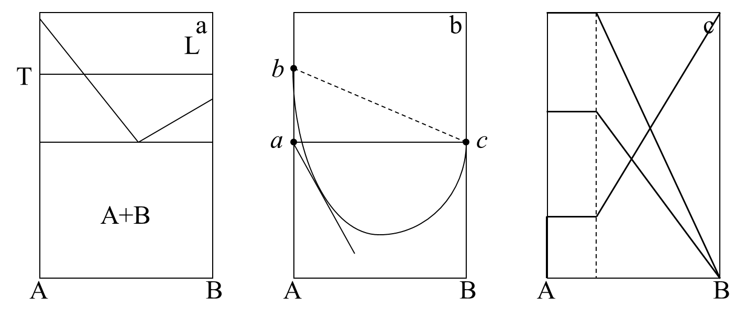
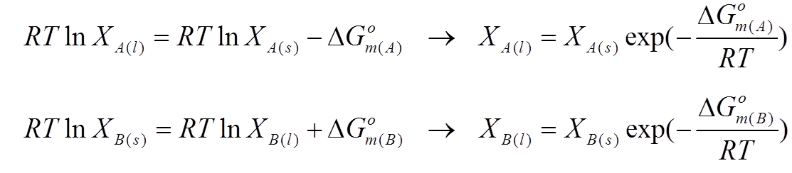
Calculate the liquid line
Of Complete liquid miscibility and solid immiscibility
L+S
Consider the equilibrium between Liquid and Solid
L: Raoultian liquid solution: a_{A(l)} = X_{A(l)}
S: pure solid A, X_{A(s)}=1 and X_{B(s)} =0

Slide 27
45. Topological evolution of Phase diagram
Chapter 10
Gibbs Free energy Composition and Phase diagrams of Binary System
Ref. Introduction to the thermodynamics of Materials, 6th edition, D. R. Gaskell, and D. E. Laughlin

Slide 28
Regular solution in both liquid and solid
Consider the binary system A–B which forms regular liquid solutions and regular solid solutions.The melting temperatures of A and B are, respectively, 800 and 1200 K.
As T_{m,(A)}<1000 K<T_{m,(B)}, liquid is chosen as the standard state for A, and solid is chosen as the standard state for B. With reference to these standard states, the Gibbs free energies of mixing are:
for the liquid solutions and
The formation of idea liquid solution
The formation of idea solid solution

Slide 29
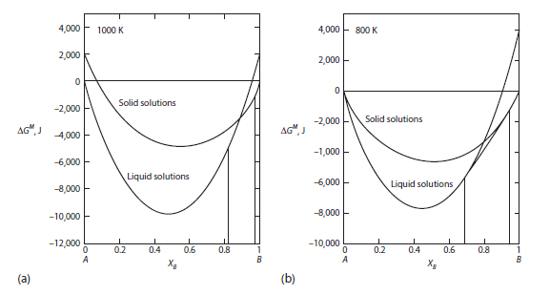
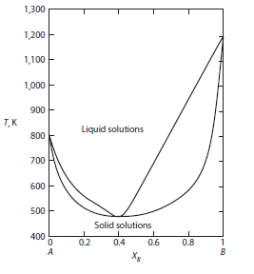
Regular solution in both liquid and solid
for the solid solutions. Inserting the numerical data gives

Slide 30

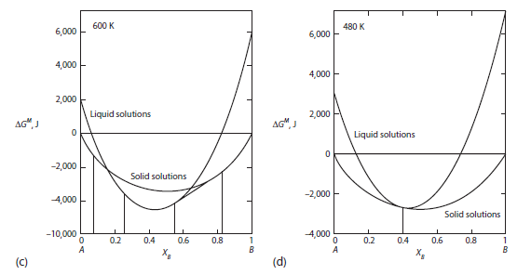
Regular solution in both liquid and solid
At temperatures lower than T_{m,(A)} and T_{m,(B)} solid is chosen as the standard state for both components:

Slide 31
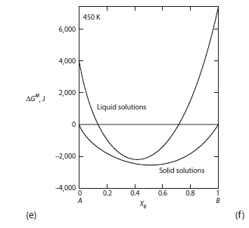
Regular solution in both liquid and solid
At temperatures lower than T_{m,(A)} and T_{m,(B)} solid is chosen as the standard state for both components:

Slide 32
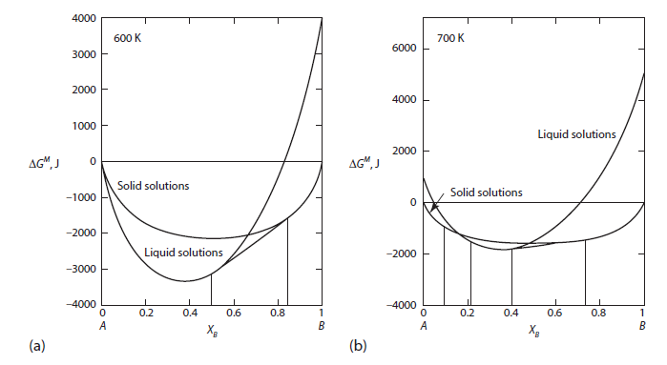
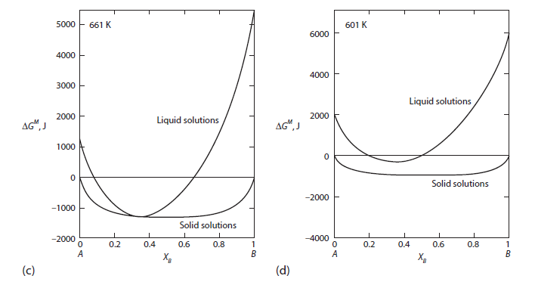
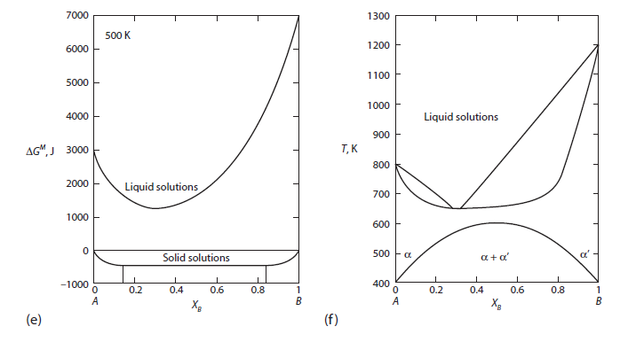
Regular solution in both liquid and solid
800K
700K
661K
601K
Phase diagram of binary system
500K
Regular solution in both liquid and solid

Slide 33
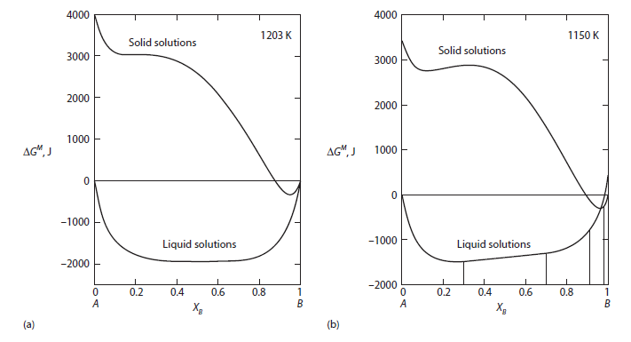
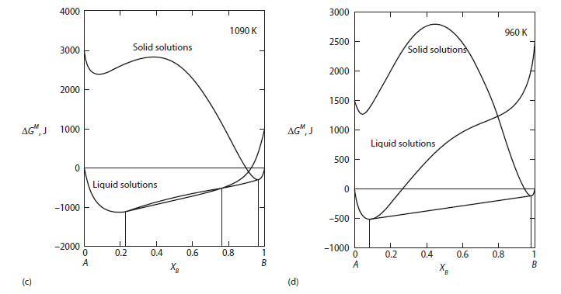
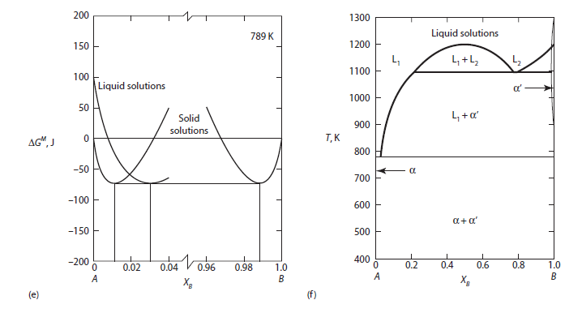
Regular solution in both liquid and solid
1090K
950K
1203K
1150K
789K
Phase diagram of binary system
Regular solution in both liquid and solid

Slide 34
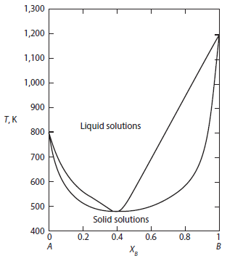
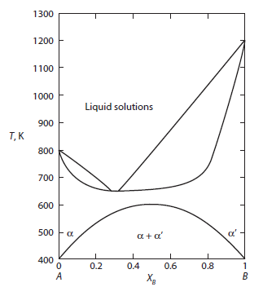
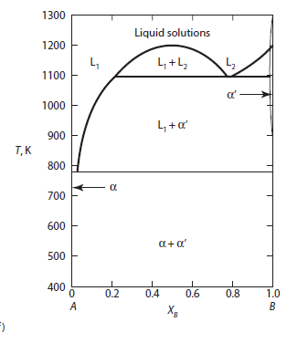
Effect of Ω_{l} and Ω_{s} on the phase diagram

Slide 35

Effect of Ω_{l} and Ω_{s} on the phase diagram
Ω_{l，}[kJ]
-20
-10
0
+10
+20
+30
+30
L
L
L
L
α+α‘
α+α‘
L+L’
L
L
L
L
L
+15
Ω_{s，}[kJ]
α+α‘
α+α‘
L
L
L
L
0
Topological changes
in the phase diagram
for a system A–B
with regular solid and liquid solutions
-15

Slide 36

Effect of Ω_{l} and Ω_{s} on the phase diagram
Ω_{s},_{l，}[kJ]
Ω_{l} =--20
Ω_{s} =30
Ω_{l} =-10
Ω_{s} =30
Ω_{l} =0
Ω_{s} =30
Ω_{l} =10
Ω_{s} =30
Ω_{l} =20
Ω_{s} =30
-10
0
+10
+20
L₁ +L₂
L
L
L
L
α+α’
α+α’
(a)
(b)
(c)
(d)
(e)
As is shown in the above Figure
the liquid solutions become increasing less stable relative to the solid phases with the consequence that the eutectic temperature is increased

Slide 37



Regular solution in both liquid and solid
Ω_{s},_{l，}[kJ]
Ω_{s} =-15
Ω_{l} =-20
Ω_{s} =0
Ω_{l} =-20
Ω_{s} =+15
Ω_{l} =-20
L
(p)
(l)
(f)
the solid phase becomes increasingly less stable than the liquid phase, which deepens the depression of the liquidus and solidus curves and eventually forms a eutectic.

